Slide 1
VCOO User Profile & Simulation
Proposed Flow and KPIs

Slide 2
1
Analyze the Business Data
2
Show YoY Insights
3
Select Relevant KPIs
0
Ingest the Business Data
4
Set Next Year’s Goals
Goal Setting

Slide 3
Prefilled by the system(duplicate from last year) – allow editing
Goal Setting UX – Simplified
2019
2020
Growth %
Target %
Target Total
X
Total Sales Revenue
X
Expense
X
Profit
X
Cash flow
Customer Growth
3. Select Relevant KPIs
1. Analyze the data
2. YoY Insights
4. Set your Next Year Goals

Slide 4
Insights
Simulator
Cashflow
Plan
Parameters with impact on Cash flow
Funding
Existing bank accounts & LoC
Simulate
Recommended Plan(s)
Funding
LoC top-up or new Lending products
Save & Send Plan
Execution
Handoff to Backoffice for review
Manual with Backoffice team
Automation (Surplus, Cashflow, Shortage)
Allow editing
Health score impact
Health score
manually
automated
Move/Track allocated funds
Execution
Impact on cash flows & health score
Simulation Process – Beta
Notes:
Items highlighted with Red are dropped off from scope for MVP only.
Funding https://temenosglobal.invisionapp.com/share/VY102ELAZFWT#/screens/448742276
Save Plan Design - https://temenosglobal.invisionapp.com/share/VY102ELAZFWT#/screens/446498749

Slide 5
This will be CWB/VCOO branded page.
Enrollment
VCOO/CWB
CODAT
Accounting Software
Invitation Email
Landing + Intro Page
Redirect to CODAT
Authorize CODAT to pull data by providing login credentials on Accounting Software
Login (with DBX credentials)
Select Accounting Software
Redirect to Accounting Software
Select the Company to import(Optional)
Connect Accounting Software
Terms and Conditions + Privacy Policy
Terms and Conditions + Privacy Policy
Enrollment Questions
This will be different for each software.
Show Dashboard
We can show this earlier in the process too.

Slide 6
1. Analyze the Business Data – KPIs
Category | KPI | Extended KPIs (Optional/Priority 2) | Description | Source
Financial | Revenue |  | From income statement | CODAT
 | Expense |  | From income statement | CODAT
 | Gross Profit |  | From income statement (Revenue-COGS) | CODAT
 |  | Operating Profit | GP-Operating Expenses | CODAT
 |  | Net Profit | OP-Interest Expenses | CODAT
 | Current Assets |  | From balance sheet | CODAT
 |  | Cash and Equivalent | Balance sheet | CODAT
 |  | Receivables | Balance sheet | CODAT
 |  | Inventory | Balance sheet | CODAT
 | Current Liabilities |  | From balance sheet | CODAT
 |  | Short term loan payments | Balance sheet | CODAT
 |  | Payables | Balance sheet | CODAT
 |  | Accrued payments | Balance sheet | CODAT
 | Retained Earnings |  | From balance sheet | CODAT
 | Net Cashflows |  | Cash flow statement | CODAT
 |  | From Operations | Cash flow statement | CODAT?
 |  | From Investments | Cash flow statement | CODAT?
 |  | From Financing | Cash flow statement | CODAT?

Slide 7
1. Analyze the Business Data – KPIs
Category | KPI | Description | Source
HR | Number of employees |  | HR System
 | Employee retention rate | Avg length of employment | HR System
Strategic | Number of customers | Count all customer IDs? | CODAT
 | Number of suppliers | Count all customer IDs? | CODAT
 | Number of products |  | ?
 | Geographic outreach |  | ?
 | Market share | Calculate percentage of business revenue against the total market size from www.statista.com/markets | Statista?
 | Recurring business | Repeating business orders | ?
Digital | Social Sensing/Engagement | Twitter, FB, Instagram | Social tools
 | NPS | Net promoter score | Website
 | Website traffic | Total visitors | GA
 | Funnel drop off rate | For ecommerce businesses | GA

Slide 8
2. Show KPI Based YoY Insights

Slide 9
3. Select Relevant KPIs (Customer Choice or Business Type)
Extended KPI | Manufacturing | Service | Retail | Online
Operating Profit | Y |  | Y
Net Profit | Y | Y | Y | Y
Tax | Y | Y | Y | Y
Interest Paid and Received | Y |  | Y | Y
Inventory | Y |  | Y
Inventory turnover | Y |  | Y
Customer acquisition cost | Y | Y | Y | Y
Marketing spend per customer | Y | Y | Y | Y
Quick ratio | Y
# of employees | Y |  | Y
# of products | Y |  | Y
NPS |  |  |  | Y
Funnel drop off rate |  |  |  | Y

Slide 10
4. Recommend Next Year Goals

Slide 11
Next Steps
Finalize the list of KPIs that we can utilize based on available data sources and business value –
Design the experience

Slide 12
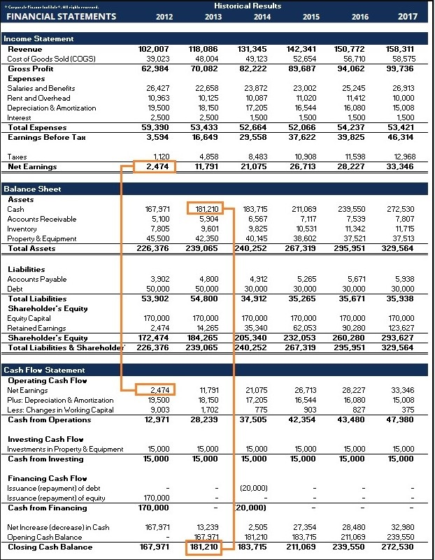
Back

Slide 13
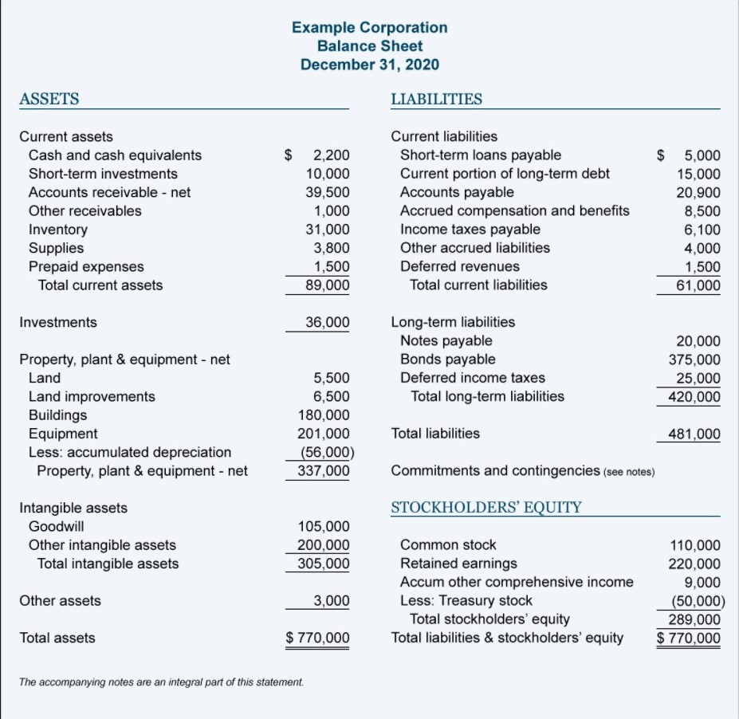
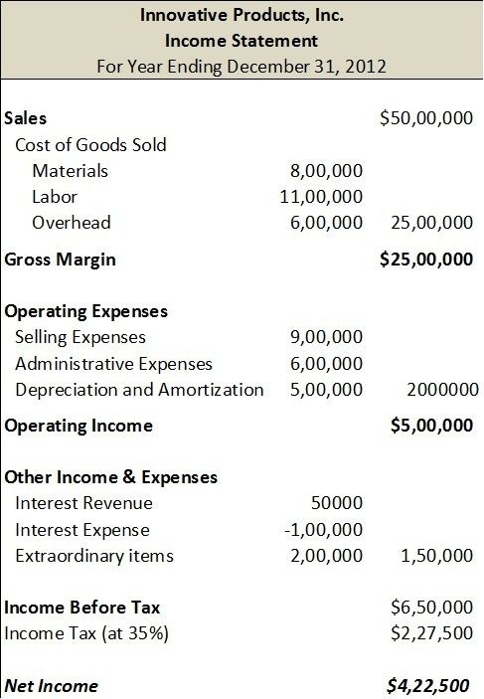
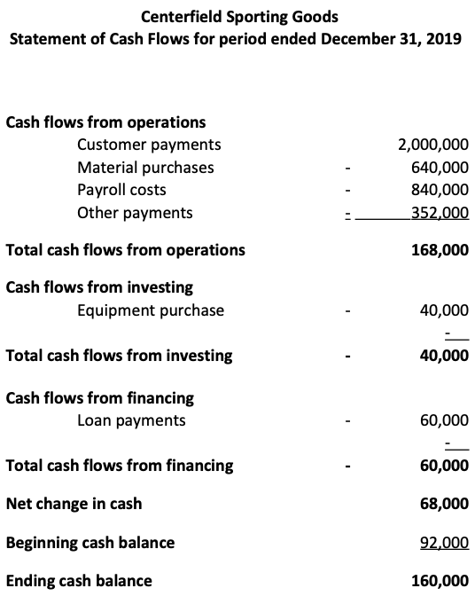
Back

Slide 14
Funding UX – Simplified
Target Funds
50,000
Chequing Account
10,000
Saving Account
20,000
Line of Credit

